Slide 1
Savior
An Artificial Intelligence based system for Network Anomaly Detection and Prevention
Roji Augustine
rojiaugustine@gmail.com
1-JAN-2019

Slide 2
BUSINESS PROBLEM
To build network intrusion detection system to detect anomalies and attacks in the Network

Slide 3
Machine Learning models
Used three different algorithms for model building
Neural Network (fast.ai)
Random Forest (scikit-learn)
K-Nearest Neighbors (scikit-learn)
Developed two machine learning models [ Total 6 models ]
Model 1 : Binomial Classification : Activity is normal or attack
Model 2 : Multinomial classification: Activity is normal or DOS or PROBE or R2L or U2R

Slide 4
How models are developed and How to test the code
Models are developed using Google Colab (K80 GPU)
To run the script (Jupyter notebook) following are the steps
Login to Colab (https://colab.research.google.com)
Copy the train (train.csv) and test data (test.csv) files to Google Drive (My Drive/ hackathon/)
Copy the Jupyter notebook also to Google Drive
While running the code, you may need to provide authorization code, after verifying your google account

Slide 5
Train and Test Data
The provided data is having a ‘attack’ variable which indicates if the activity is normal or any of the 39 attack types ('back', 'land', 'neptune', 'pod', 'smurf', 'teardrop', 'apache2', 'processtable', 'worm', 'udpstorm', 'mailbomb', 'buffer_overflow', 'loadmodule', 'perl', 'rootkit', 'sqlattack', 'xterm', 'ps', 'ftp_write', 'guess_passwd', 'imap', 'phf', 'multihop', 'warezclient', 'warezmaster', 'spy', 'xlock', 'xsnoop', 'snmpgetattack', 'snmpguess', 'httptunnel', 'sendmail', 'named', 'satan', 'ipsweep', 'portsweep', 'nmap', 'mscan', 'saint')
Attack types {'spy', 'warezclient'} are present only in test data and not in train data. So both test and train data set is combined to make a larger data set and training and test data is derived from this larger data set. Currently 20% of the total data is considered for testing the model. This can be changed by changed the variable test_percent in the script
The column last_flag doesn’t have any significance on the model. So this column is removed from the data set

Slide 6
Preprocessing
Preprocessing for Neural Netowrk : Feature values (X Values) are divided into two groups - Categorical and Continuous variables, before feeding into the Neural Network model. Preprocessing for Neural Network is done using the processes [FillMissing, Categorify, Normalize] . Categorical and Continuous variables are treated separately in the neural network. Categorify is for the Categorical variables and Normalize is for the continuous variables
Preprocessing for Random Forest and KNN : The non-numerical data is converted into Numerical data using the method handle_non_numerical_data
The same preprocessing is done for both train and test data

Slide 7
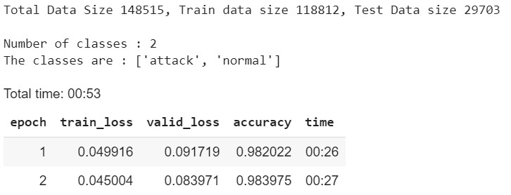
Model 1
Model 1 is a Binomial Classifier to classify activity is normal or attack
We need to create a new label ('attack_flag') column (y values), which indicates whether the activity is ‘attack’ or ‘normal’. It is created with the expression
df1['attack_flag'] = df1['attack'].apply(lambda attack : attack if attack == 'normal' else 'attack')
Feature values (X Values) are divided into two groups - Categorical and Continuous variables, before feeding into the model
Neural Network Model
Used fast.ai for creating neural network.
Neural network with two hidden fully connected layers of size 200 and 100 are used
Please refer the slide comparing the fast.ai and Keras
Achieved 98% accuracy, just with 2 epochs and the default learning rate (1e-3)

Slide 8
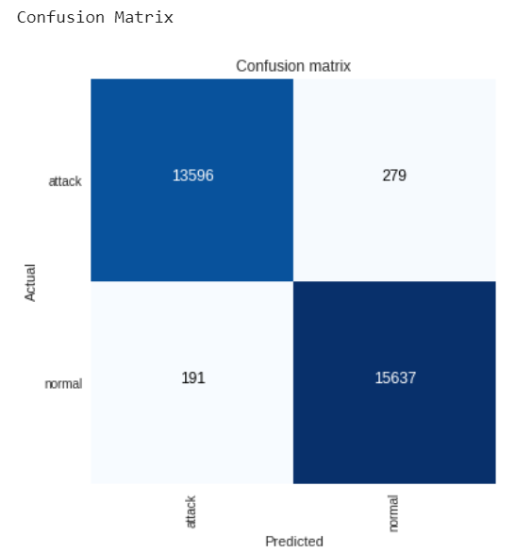
Model 1 contd..
confusion matrix by
Neural Network Model
The dark colored boxes on the diagonal indicate the number of instances the
test data classified correctly. The light colored boxes indicate
the Number of occurrences wrongly classified
The accuracy of the model can be further improved by
adjusting number of epochs and the learning rate, and also
by increasing the neural network layers without overfitting
for a large dataset

Slide 9
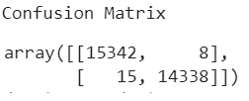
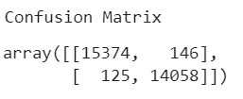
Model 1 contd..
Random Forest Model
Used scikit-learn for creating the model
Achieved 99% accuracy by using the default parameters.
Fine tuning can be done by changing model parameters when a large dataset is available
Accuracy : 0.9993603339729994, AUC Metric : 0.9993556043749927
Confusion matric for Random Forest model given in the right side
Most of the test data is correctly classified
K-Nearest Neighbors Model
Used scikit-learn for creating the model
Achieved 99% accuracy by using the default parameters.
Fine tuning can be done by changing model parameters when a large dataset is available
Accuracy : 0.9913140086859913, AUC Metric : 0.9913795424256431
Confusion matric for K-Nearest Neighbors model given in the right side
Most of the test data is correctly classified
Summary : We can conclude that Random Forest model is performed best by seeing accuracy and the
Confusion Matrix. However for a larger data set, it is recommended to use Neural Network Model

Slide 10
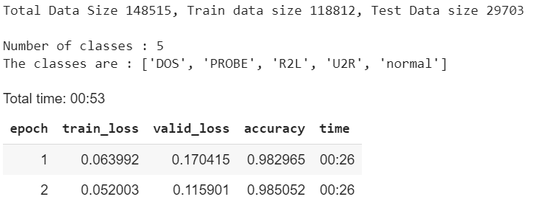
Model 2
Model 2 is a Multinomial classification to classify activity is normal or DOS or PROBE or R2L or U2R
We need to create a new label ('attack_category') column (y values), which indicates whether the activity is ‘attack’ or ‘normal’. A python dictionary is created to hold each attack type and its catefory. The new label is created with the expression
df2['attack_category'] = df2['attack'].apply(lambda attack : dict_attack_to_category[attack])
Neural Network Model
Used fast.ai for creating neural network.
Please refer the slide comparing the fast.ai and Keras
Achieved 98% accuracy, just with 2 epochs and the default learning rate (1e-3)

Slide 11
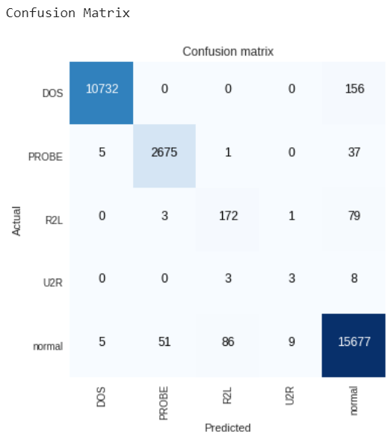
Model 2 contd..
confusion matrix by
Neural Network Model
The diagonal starting and ending with dark colored boxes indicate the number of instances the
test data classified correctly. The other boxes indicate the
Number of occurrences wrongly classified
The accuracy of the model can be further improved by
adjusting number of epochs and the learning rate, and also
by increasing the neural network layers without overfitting
for a large dataset

Slide 12
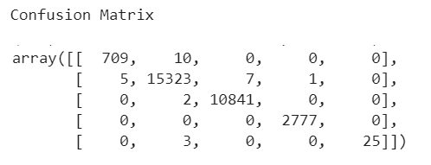
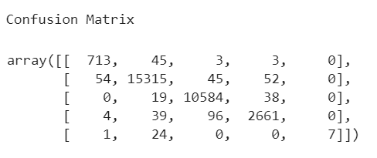
Model 2 contd..
Random Forest Model
Used scikit-learn for creating the model
Achieved 99% accuracy by using the default parameters.
Fine tuning can be done by changing model parameters when a large
dataset is available
Accuracy : 0.9990573342759991
Confusion matric for Random Forest model given in the right side
Most of the test data is correctly classified
K-Nearest Neighbors Model
Used scikit-learn for creating the model
Achieved 99% accuracy by using the default parameters.
Fine tuning can be done by changing model parameters when a large
dataset is available
Accuracy : 0.9857590142409858
Confusion matric for K-Nearest Neighbors model given in the right side
Most of the test data is correctly classified
Summary : We can conclude that Random Forest model is performed best by seeing accuracy and the
Confusion Matrix. However for a larger data set, it is recommended to use Neural Network Model

Slide 13
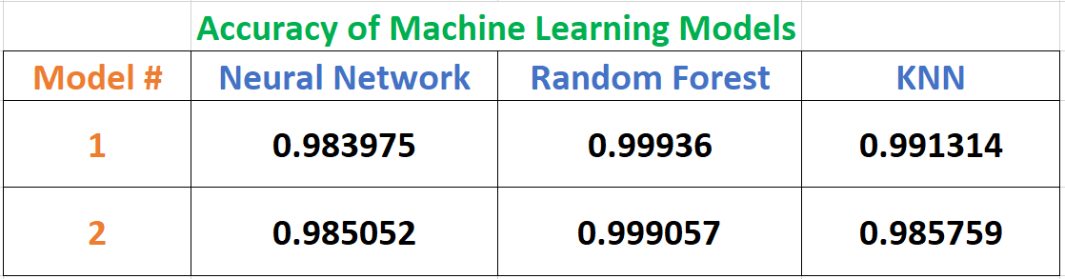
Comparison of Accuracy
We can conclude that Random Forest model is performed best by seeing accuracy and the Confusion Matrix. However for a larger data set, it is recommended to use Neural Network Model

Slide 14
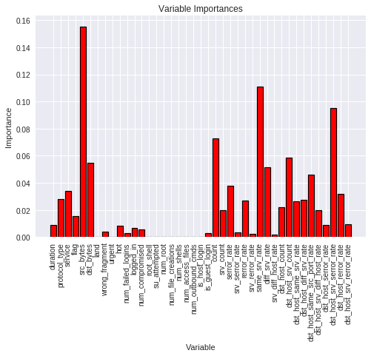
Feature Reduction
Use of the feature importance to decrease the number of features for random forest model

Slide 15
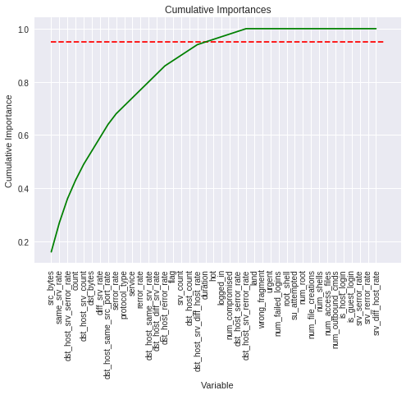
Feature Reduction contd..
Cumulative importance graph shows the contribution to the overall importance of each additional variable. The dashed line is drawn at 95% of total importance accounted for

Slide 16
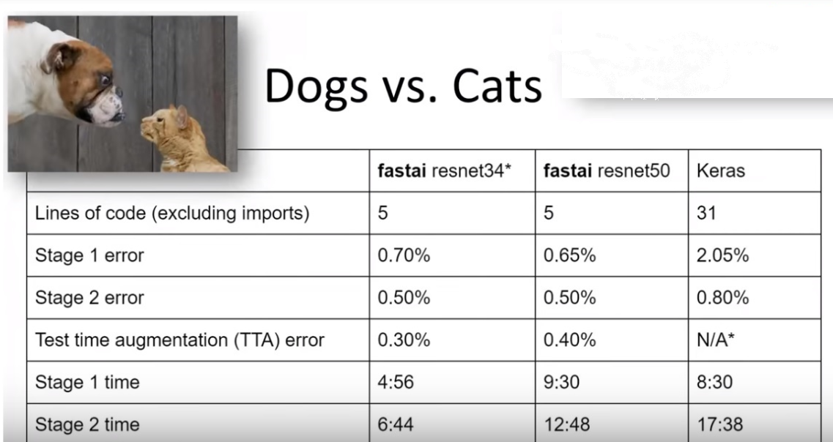
fast.ai Vs Keras : Reason for choosing fast.ai over Keras

Slide 17
Thank You

